Slide 1
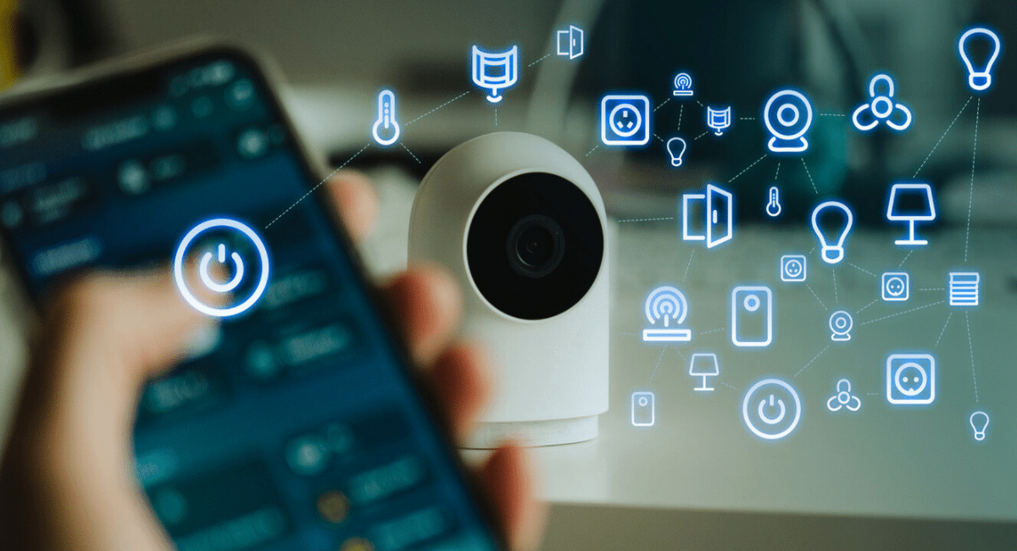
Designing and Describing an IoT Device

Slide 2
Design & Brainstorming: “IoT on the Human Body”
Design and draw or paste the images of at least 3 IoT personal devices that a person could wear or carry (example: smart glasses).
Discuss the main features of each device and add the information next to the drawings:
Sensors
Connectivity
Function
Data collected

Slide 3
